Slide 1


Module 2: R for Data Science

Slide 2
Learning objectives of this module:
Introduction to data analysis
Learn the basic vocabulary of dplyr
Exercise commands
Translating questions into data manipulation statements
Visit the tidyr package
Learn the why and how of Exploratory Data Analysis (EDA).

Slide 3
Terms
A variable is a quantity, quality, or property that you can measure.
A value is the state of a variable when you measure it. The value of a variable may change from measurement to measurement.
An observation is a set of measurements made under similar conditions (you usually make all of the measurements in an observation at the same time and on the same object). An observation will contain several values, each associated with a different variable. I’ll sometimes refer to an observation as a data point.
Tabular data is a set of values, each associated with a variable and an observation. Tabular data is tidy if each value is placed in its own “cell”, each variable in its own column, and each observation in its own row.

Slide 4
Variation
The tendency of the values of a variable to change from measurement to measurement.
You can see variation easily in real life; if you measure any continuous variable twice, you will get two different results. This is true even if you measure quantities that are constant, like the speed of light.
Each of your measurements will include a small amount of error that varies from measurement to measurement.
Categorical variables can also vary if you measure across different subjects (e.g. the eye colors of different people), or different times (e.g. the energy levels of an electron at different moments).
Every variable has its own pattern of variation, which can reveal interesting information. The best way to understand that pattern is to visualize the distribution of the variable’s values.

Slide 5
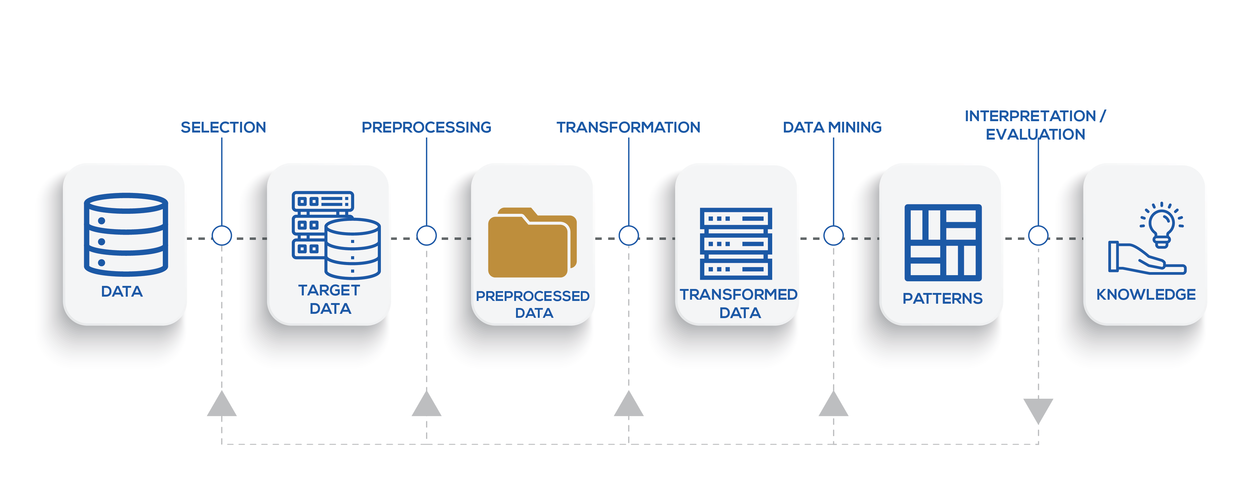
Knowledge Discovery Process
Notes:
Steps of data analysis
1. Data collection - combination of the following: a) answering other related questions, b) dealing with data quality issues that are later realized, and, c) including new data sets to the analysis
2. Quality checks and cleaning with imperfect data. It is common to have missing values or measurements that are noisy.
High-throughput genomics data embeds technical biases into the data
3. Data processing - How to combat data not coming into a ready to analyze format
see relationship between variables measured, relationship between samples based on the variables measured.
EDA and modeling.
This generally refers to modeling your variable of interest based on other variables you measured. In the context of genomics, it could be that you are trying to predict disease status of the patients from expression of genes you measured from their tissue samples. Then your variable of interest is the disease status and
4. Visualization Basic plots: Histograms, scatter plots, bar plots, box plots, heatmaps
ideograms and circos plots for genomics provides visualization of different features over the whole genome.

Slide 6
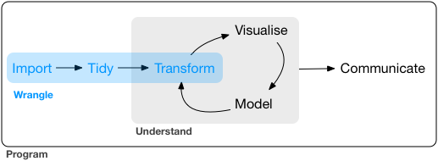
Notes:
D
ata Wrangling with dplyr and tidyr 1. Source data ➡️
Experimental data
External data sets
Manually collected data and meta data
2. Intermediate ➡️
Derived data
Computatation
Manual curation
Tidy data - Definitions
Principles of tidy data to structure data
Find errors in existing data sets
Structure data
Some reshaping data with tidyr
- Comments
Cleaning data also requires dplyr
tidyr and dplyr are intertwined
Focus on tidy data
Introduction of tidyr ways
Other tidyr functionality will be covered in dplyr and broom lectures.
3. Analysis ➡️
Exploratory analysis
Statistical models
Hypothesis testing
4. Manuscript
Can you reproduce your work?
All numbers
Summaries
Images

Slide 7
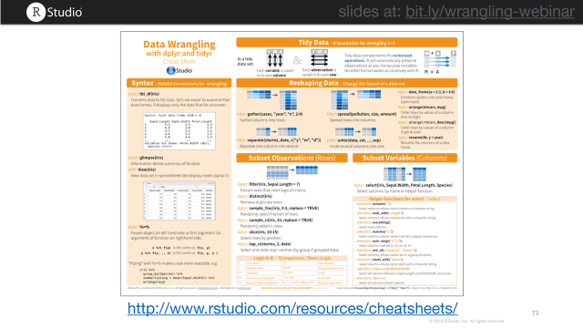
Tidy Data - A foundation for wrangling in R
Syntax - Helpful conventions for wrangling
Reshaping Data - Change the layout of a data set
Subset Observations (Rows), Subset Variables (Columns)
Summarize Data
Make New Variables
Combine Data Sets
Group Data
Notes:
Using tidyr to reshape data frames

Slide 8
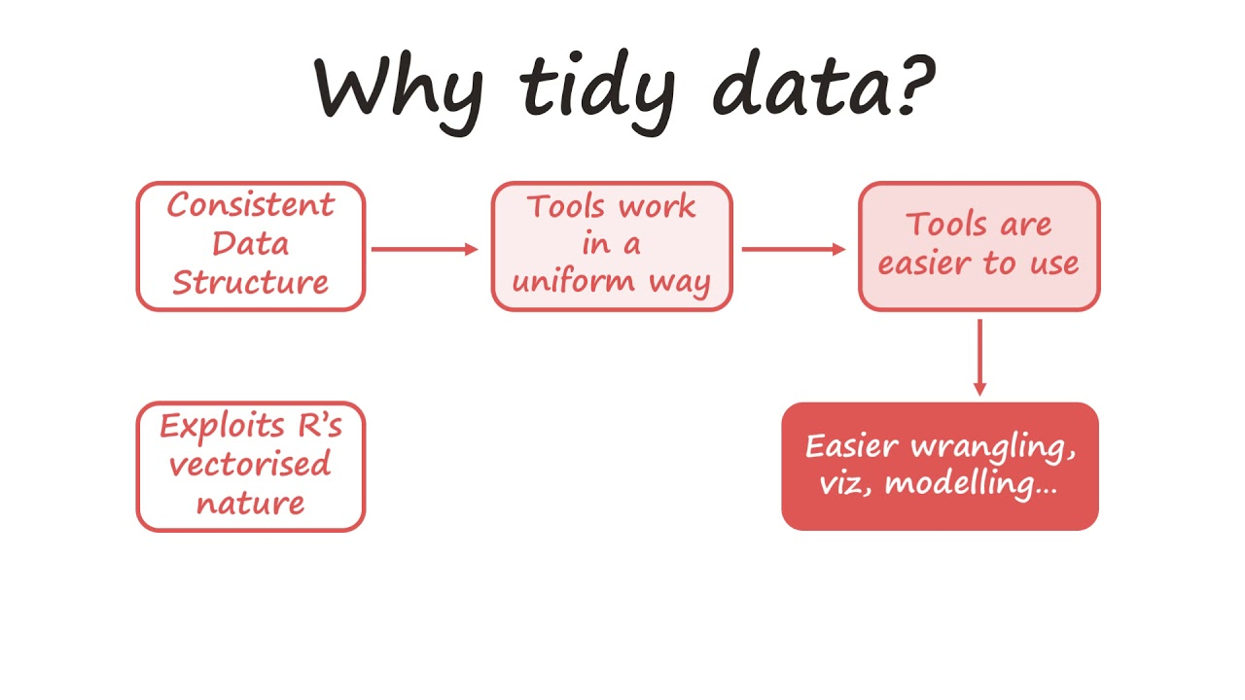
Notes:
Data wrangling is the process of cleaning messy and complex data sets to enable convenient consumption and further analysis. This is a very important and time taking process in data science. R has an extensive library of tools for database manipulation and wrangling.
Tidying allows you to manipulate the structure of your data while preserving all original information. Many functions in R require (or work better) with a data structure that isn't always easily readable by people.
In contrast to aggregation, which reduces many cells in the original data set to one cell in the new dataset, tidying preserves a one-to-one connection. Although aggregation can be done with many functions in R, the tidyr package allows you to both reshape and aggregate within a single syntax.
- Some of the popular packages for data manipulation in R include:
dplyr Package – Created and maintained by Hadley Wickham, dplyr is best known for its data exploration and transformation capabilities and highly adaptive chaining syntax.
- data.table Package – It allows for faster manipulation of data set with minimum coding. It simplifies data aggregation and drastically reduces the compute time.
- readr Package – ‘readr’ helps in reading various forms of data into R. By not converting characters into factors it performs the task at 10x faster speed.
Problem –
Column headers are values, not variable names (gather)
Multiple variables stored in one column (separate)
Variables are stored in both rows and columns (gather-spread)
Repeated observations (nest or table)
Multiple types in one table (dplyr data transformation)
One type in multiple tables (dplyr, combine into single table)

Slide 9
The tidyr package is used to manipulate the structure of your data while preserving all original information, using the following functions:
gather() our data (wide –> long)
spread() our data (long –> wide)
Tame Data
Tidy Data
Variables
Gather()
Observations
Spread()
Values
Notes:
The wide format is generally untidy but found in the majority of datasets
Tame data does not equal tidy data
Each variable forms a column
Each observation forms a row
Each type of observational unit forms a table
Wide vs. long data
Wide format data has a separate column for each variable or each factor in your study. One row therefore can therefore include several different observations.
The wide format makes computation on columns sometimes easier
Long format data has a column stating the measured variable types and a column containing the values associated to those variables (each column is a variable, each row is one observation). This is considered “tidy” data because it is easily interpreted by most packages for visualization and analysis in R.
The format of your data depends on your specific needs, but some functions and packages such as dplyr, lm(), glm(), gam() require long format data. The ggplot2 package can use wide data format for some basic plotting, but more complex plots require the long format (example to come).
Additionally, long form data can more easily be aggregated and converted back into wide form data to provide summaries, or to check the balance of sampling designs.

Slide 10
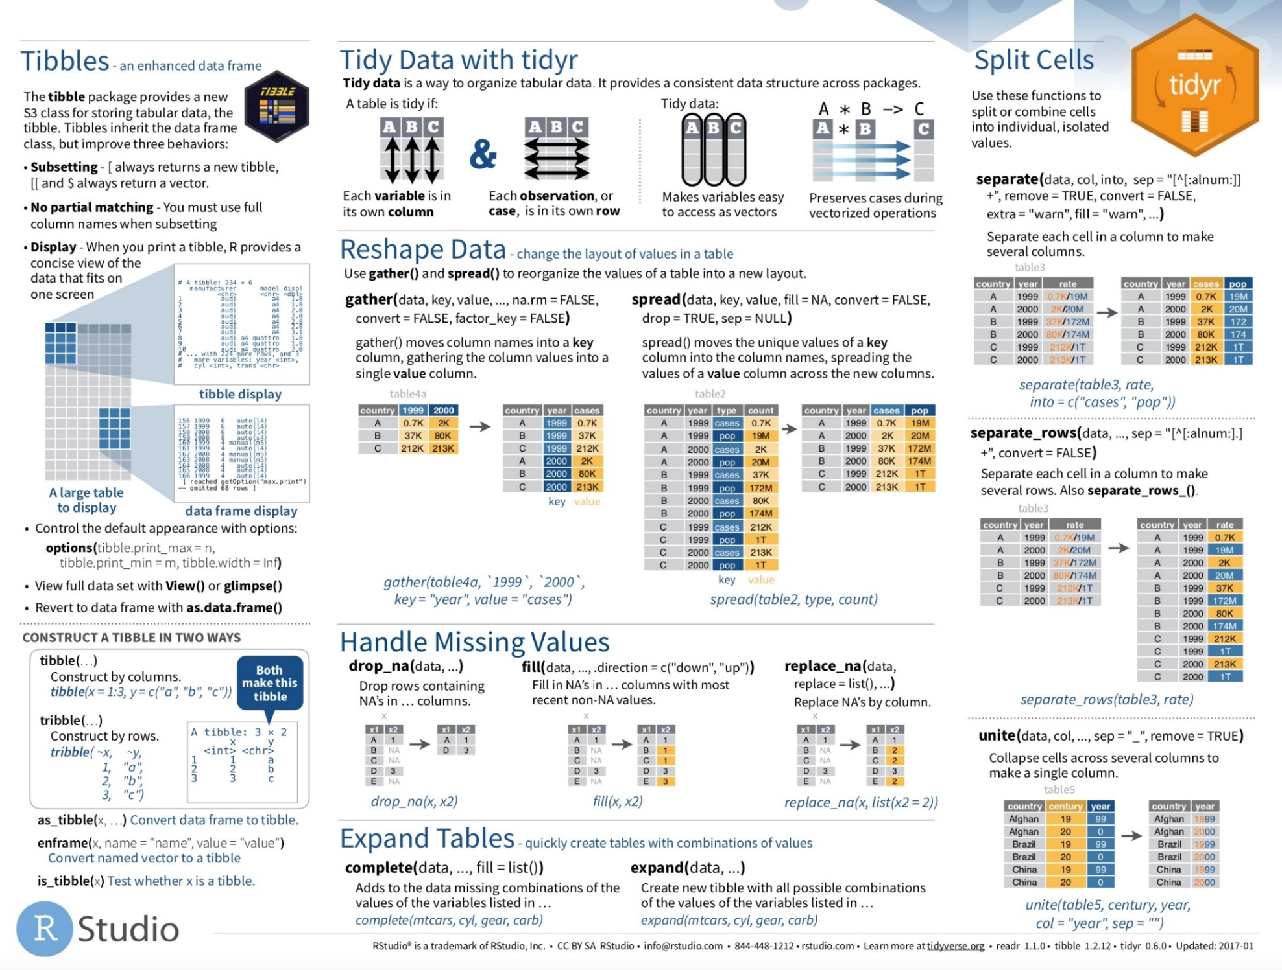
http://tidyr.tidyverse.org/ vignette("tidy-data")
Notes:
Tidyr functionality (cheatsheets)
- Tidy data coverage
Basic column-wise manipulation
now
Reshaping operations
after dplyr
Nesting and advanced collapsing operations
after broom

Slide 11
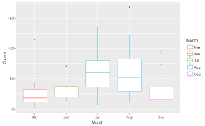
?air.quality
data(airquality)
Gather() all the columns (except Month and Day) into rows.
Then spread() the resulting dataset to return the same data format as the original data.
Notes:
# Use gather() to convert the dataset to long format
air.long <- gather(airquality, variable, value, -Month, -Day)
head(air.long)
# Note that the syntax used here indicates we wish to gather ALL the columns except "Month" and "Day"
# Then, use spread() to convert the dataset back to wide format
air.wide <- spread(air.long , variable, value)
head(air.wide)
The function requires at least 3 arguments:
data: a data frame (e.g. “wide”)
key: name of the new column containing variable names (e.g. “Measurement”)
value: name of the new column containing variable values (e.g. “Value”)
…: name or numeric index of the columns we wish to gather (e.g. “DBH” or “Height”)
wide <- data.frame(Species = c("Oak", "Elm", "Ash"),
DBH = c(12, 20, 13),
Height = c(56, 85, 55))
Wide
Species DBH Height 1 Oak 12 56 2 Elm 20 85 3 Ash 13 55
# Gathering columns into rows
> long <- gather(wide, Measurement, Value, DBH, Height)
Long
spread() uses the same syntax as gather(). The function requires 3 arguments:
data: A data frame (e.g. “long”)
key: Name of the column containing variable names (e.g. “Measurement”)
value: Name of the column containing variable values (e.g. “Value”)
# Spreading rows into columns
> wide2 <- spread(long, Measurement, Value)
wide2
Species DBH Height 1 Ash 13 55 2 Elm 20 85 3 Oak 12 56

Slide 12

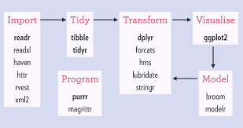

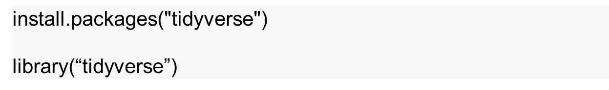
https://www.tidyverse.org/
https://github.com/rstudio/master-the-tidyverse/archive/master.zip
Notes:
An opinionated collection of R packages designed for data science.
All packages share an underlying design philosophy, grammar, and data structures.
Wrangle data with R's dplyr package
Visualize data with R's ggplot2 package
Fit models with base R
Document your work reproducibly with R Markdown

Slide 13
Tidy Data
See the paper Tidy Data by Hadley Wickham in Journal of Statistical Software (2014)
https://github.com/rstudio/master-the-tidyverse/archive/master.zip
All material is permissively licensed under CC-BY-SA 4.0.
Notes:
Putting this into Practice

Slide 14
Data Wrangling
Importation Cleaning Structuring
Missing Data
Dates & Time HTML Parsing
String Processing Text Mining
Notes:
Introduction to Data Analysis
Data analysis can be divided into three parts
Extraction: First, we need to collect the data from many sources and combine them. - dplyr
Transform: This step involves the data manipulation. Once we have consolidated all the sources of data, we can begin to clean the data.
Visualize: The last move is to visualize our data to check irregularity.
Useful data manipulation packages
The dplyr library is fundamentally created around four functions to manipulate the data and five verbs to clean the data. After that, we can use the ggplot library to analyze and visualize the data.
the basic tools needed to make your data behave, including data reshaping, regular expressions and other text manipulation tools.
Select
Mutate
work with “tibbles” instead of R’s traditional data.frame. Tibbles are data frames, but they tweak some older behaviours to make life a little easier.

Slide 15

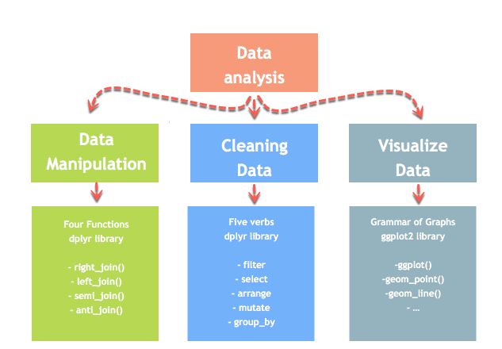
Data Wrangling – Dplyr Package
Notes:
One of the most time consuming steps in any data analysis is cleaning the data and getting it into a format that allows analysis. In this section, you will learn all about tools in R that make data wrangling.
The dplyr library is fundamentally created around four functions to manipulate the data and five verbs to clean the data. After that, we can use the ggplot library to analyze and visualize the data.
dplyr supersedes previous packages from Hadley Wickham
reshape
reshape2
plyr
Do not use these packages! All functionality can be found in dplyr or tidyr.

Slide 16
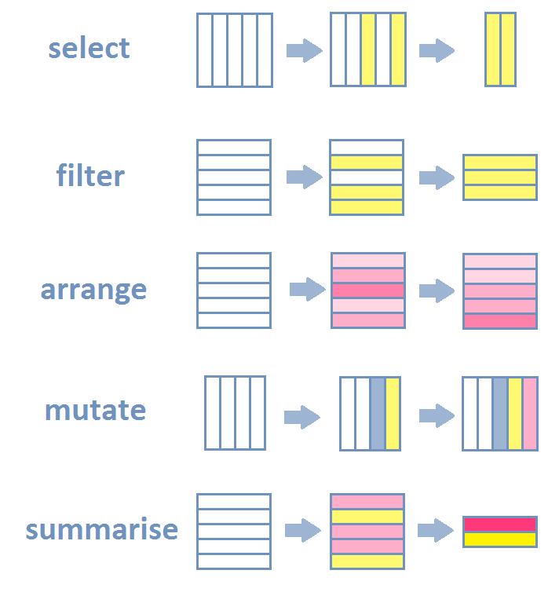
Inspect your tibble (glimpse())
Select specific columns (select())
Filter out a subset of rows (filter())
Reorders rows by one or multiple columns (arrange())
Change or add columns (mutate())
Group observations by a grouping variable (group_by())
Get a summary (in particular per group) (summarise())
Join two distinct tibbles by a common column (left_join(), right_join() and full_join())
Source: http://perso.ens-lyon.fr/lise.vaudor/dplyr/
Notes:
- built around a core set of “verbs”
select(): select columns from a data frame
filter(): filter rows according to defined criteria
arrange(): re-order data based on criteria (e.g. ascending, descending)
mutate(): create or transform values in a column

Slide 17
select(dataframe, column1, column2, …)
filter(dataframe, logical statement 1, logical statement 2, …)
arrange(data, variable1, desc(variable2), …)
mutate(data, newVar1 = expression1, newVar2 = expression2, …)
Source: http://perso.ens-lyon.fr/lise.vaudor/dplyr/
Notes:
select(data, column1, column2) # select columns 1 and 2
select(data, c(3:5,8) # select columns 3 to 5 and 8
select(data, -column2) # select all columns except column 2
select(data, start_with(y.)) # select all columns that start with “y.“
head(airquality)
> ozone <- select(airquality, Ozone, Month, Day)
> september <- filter(airquality, Month == 9, Temp >= 90) > head(september)
> air_mess <- sample_frac(airquality, 1)
> head(air_mess)
> air_chron <- arrange(air_mess, Month, Day)
> head(air_chron)
airquality_C <- mutate(airquality, Temp_C = (Temp-32)*(5/9))
> head(airquality_C)

Slide 18
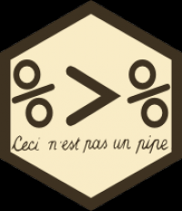
Magrittr package: using the pipe operator
Pipe operators provide ways of linking functions together so that the output of a function flows into the input of next function in the chain.
Specify the dataset first, then “pipe” into the next function in the chain.
Notes:
The advantages of this approach are that our code is less redundant and functions are executed in the same order we read and write them, which makes its easier and quicker to both translate our thoughts into code and read someone else's code and grasp what is being accomplished.
In RStudio we can insert this pipe quickly using the following hotkey: Ctrl (or Cmd for Mac) +Shift+M
june_C <- airquality %>% filter(Month == 6) %>% mutate(Temp_C = (Temp-32)*(5/9))

Slide 19
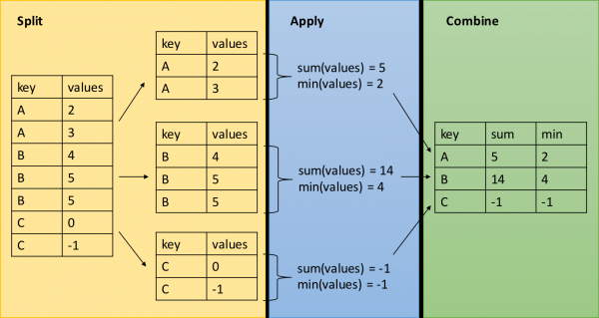
group_by(): group data frame by a factor for downstream commands (usually summarise)
summarise(): summarise values in a data frame or in groups within the data frame with aggregation functions (e.g. min(), max(), mean(), etc…)
Notes:
- The verbs are powerful when we link them with each other using the pipe operator (%>%) and by applying them to groups of observations.
- functions allow us to split our data frame into distinct groups on which we can then perform operations individually, such as aggregating/summarising:
Old strategy is the Split-Apply-Combine strategy that was initially implemented in the plyr package on which dplyr is built.
month_sum <- airquality %>% group_by(Month) %>% summarise(mean_temp = mean(Temp), sd_temp = sd(Temp))
month_sum
Source: local data frame [5 x 3]
Month mean_temp sd_temp
(int) (dbl) (dbl)
1 5 65.54839 6.854870
2 6 79.10000 6.598589
3 7 83.90323 4.315513
4 8 83.96774 6.585256
5 9 76.90000 8.355671

Slide 20
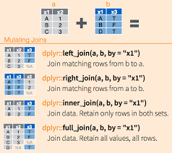
Functions that allow you to join two data frames together.
Notes:
left_join()
right_join()
inner_join()
anti_join()

Slide 21
Replacing blanks in data
na.strings = '..‘
This allows R to replace those blanks in the dataset with NA. This will be useful and convenient later when we want to remove all the ‘NA’s.

